Slide 1



Ad_Hoc Insights
CONSUMER GOODS

Slide 2



Purpose & Overview:
Atliq Hardwares is a leading computer hardware producer in India and is expanding globally. It seeks to hire junior data analysts and is conducting a SQL challenge to evaluate technical and soft skills. Results will inform hiring decisions and support data-driven decision making for company growth.
Background & Requirements:
•Atliq Hardwares is seeking insights on 10 ad hoc requests to inform business decisions
•A SQL query-based solution is required to answer the requests
Project Execution:
•Review all the ad-hoc-requests.
•Run SQL queries to answer ad hoc requests
•Create a visually appealing and engaging presentation to communicate insights
•Deliver the presentation to top-level management.

Slide 3
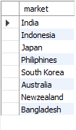
Atliq Exclusive APAC Market Presence
Question 1.
Provide the list of markets in which customer "Atliq Exclusive" operates its business in the APAC region.
output

Slide 4
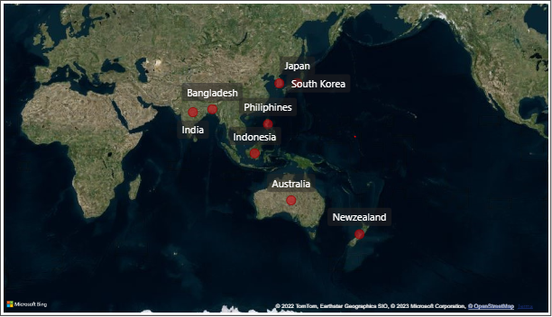
Insights:
The customer 'Atliq Exclusive' operates in the APAC region, with markets present in India, Indonesia, Japan, Philippines, South Korea, Australia, New Zealand, Bangladesh.

Slide 5

Percentage Increase in Unique Products from 2020 to 2021
Question 2.
What is the percentage of unique product increase in 2021 vs. 2020? The final output contains these fields:
a) unique_products_2020
b) unique_products_2021
c) percentage_chg
output

Slide 6
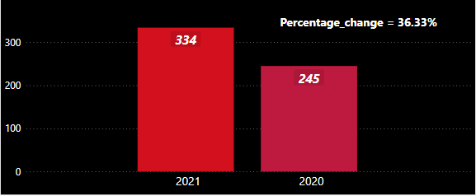
Insights:
The year-over-year comparison of sales figures reveals a substantial increase from 245 in 2020 to 334 in 2021, representing a 36.33% growth.
This positive change indicates the company's ability to effectively drive revenue and improve its market position.
The sales growth highlights the company's success in capturing new opportunities and delivering results for its stakeholders.

Slide 7
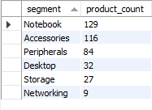
Unique Product Counts by Segment
Question 3.
Provide a report with all the unique product counts for each segment and sort them in descending order of product counts.
The final output contains 2 fields:
a) segment
b) product_count
output

Slide 8
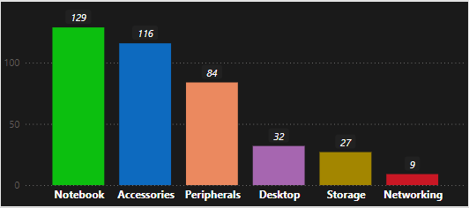
Insights:
This report provides a comprehensive overview of unique product counts for each segment within the company. The data is sorted in descending order of product counts.
This analysis provides insights into the segment-level performance and helps to identify areas of the business with potential for further growth.

Slide 9
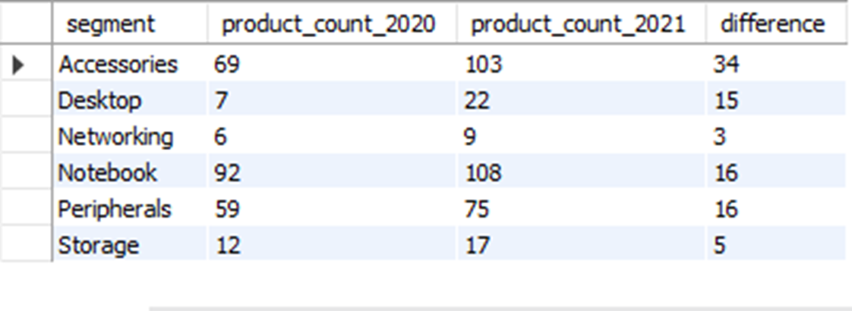
Segment-wise Comparison of Unique Products in 2020 and 2021
Question 4.
Which segment had the most increase in unique products in 2021 vs 2020? The final output contains these fields:
a) segment
b) product_count_2020
c) product_count_2021
d) difference
output

Slide 10
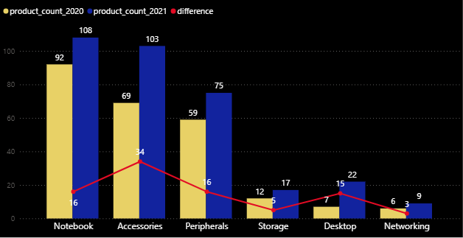
Insights:
A line and clustured column chart is being created to visually compare the product count for 2020 and 2021 for each segment, with the difference between the two shown as a line in the same plot. Based on the comparison of product count in the two years, it appears that there were more unique products in 2021 than in 2020. The segment ‘Accessories’ had the highest increase i.e 49.28% from the year 2020.
This could indicate that the company has made significant efforts to introduce new products and expand its product line, potentially to stay competitive.

Slide 11
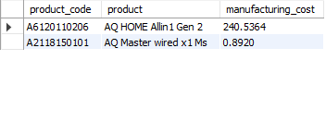
Products with Highest and Lowest Manufacturing Costs
Question 5.
Get the products that have the highest and lowest manufacturing costs. The final output should contain these fields:
product_code
product
manufacturing_cost
output

Slide 12
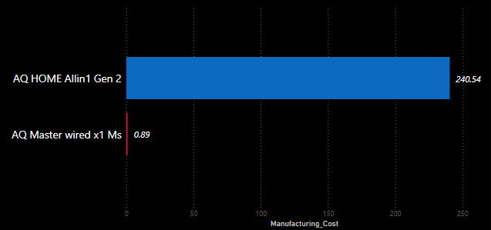
Insights:
We can now clearly see ‘AQ HOME Allin 1Gen 2’ has the highest and ‘AQ Master wired x1 Ms’ has the lowest manufacturing costs in the data.
Understanding the manufacturing costs of the products can help the company to make decisions about product development and design, as they can focus their resources on developing products with lower manufacturing costs to increase profitability.

Slide 13
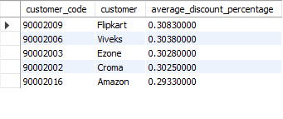
Top 5 Customers with Highest Discount % in FY 2021 (Indian Market)
Question 6.
Generate a report which contains the top 5 customers who received an average high pre_invoice_discount_pct for the fiscal year 2021 and in the Indian market. The final output contains these fields:
a) customer_code
b) customer
c) average_discount_percentage
output

Slide 14
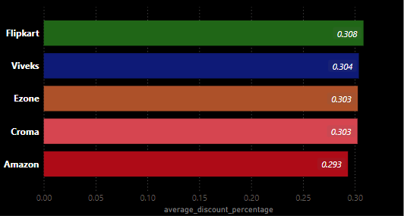
Insights:
Flipkart, Viveks, Ezone, Croma, and Amazon are the top 5 customers that received the highest average pre-invoice discount percentage in the Indian market for the fiscal year 2021.
This could indicate that these customers are important to the company and that providing them with discounts may have a positive impact on the company's revenue.

Slide 15
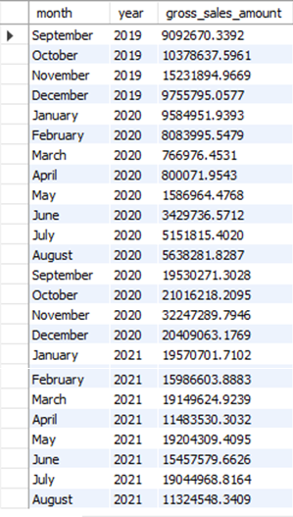
Monthly Gross Sales Analysis for Customer 'Atliq Exclusive'
Question 7.
Get the complete report of the Gross sales amount for the customer “Atliq Exclusive” for each month. This analysis helps to get an idea of low and high-performing months and take strategic decisions. The final report contains these columns:
Month
Year
Gross sales Amount
output

Slide 16
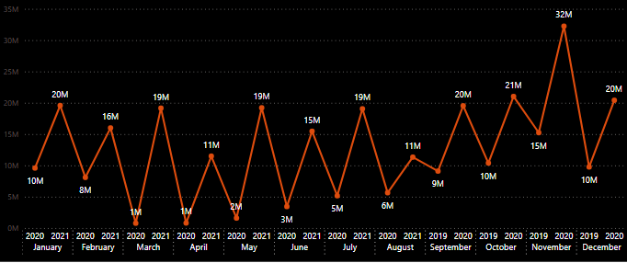
Insights:
This is the insight that provides a detailed overview of the gross sales amount for the customer "Atliq Exclusive" for each month and it shows November has the highest gross sales.
This information can be used to identify the low and high-performing months, to forecast future sales and the company can adjust their strategies accordingly to meet the demands of the customer.

Slide 17

Quarterly Analysis of Total Sold Quantity in 2020
Question 8.
In which quarter of 2020, got the maximum total_sold_quantity? The final output contains these fields:
(sorted by) total_sold_quantity
Quarter
output

Slide 18
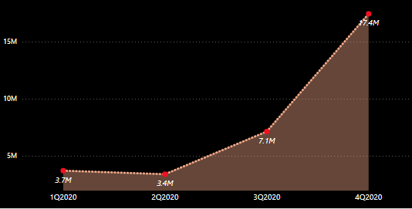
Insights:
By observing the heights of the bars, we can quickly determine Quarter 4 of 2020 had the highest sales i.e 17.4M. This information can be useful in understanding the sales trend and performance of products over time.

Slide 19

Channel-wise Gross Sales Analysis and Contribution in FY 2021
Question 9.
Which channel helped to bring more gross sales in the fiscal year 2021 and the percentage of contribution? The final output contains these fields:
channel
gross_sales_mln
percentage
output

Slide 20
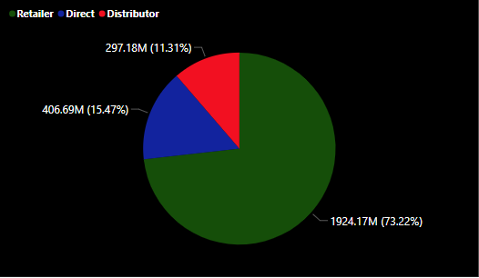
Insights:
We can see from the insight of this report is that it helps the channel ‘Retailer’ contributed the most to the company's gross sales in the fiscal year 2021.
By analyzing the percentage of contribution for each channel, the company can increase marketing efforts or optimize the supply chain towards the most effective channels.

Slide 21
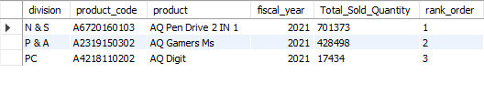
Top 3 Best-Selling Products by Division in FY 2021
Question 10.
Get the Top 3 products in each division that have a high total_sold_quantity in the fiscal_year 2021? The final output contains these fields:
division
product_code
product
total_sold_quantity
rank_order
output

Slide 22
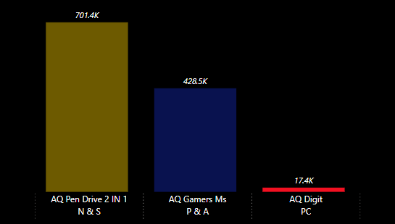
Insights:
This information provides insight into the top-performing products and divisions in terms of total sold quantity in 2021.
Here we can see the product ‘AQ Pen Drive 2 IN 1’ of the division N & S is driving the most sales revenue and ‘AQ Digit’ of the division PC may require additional resources or attention.

Slide 23
Thank You!

